Slide 1
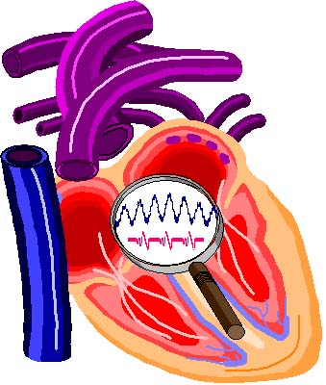
Privacy Requirements
Phoenix
Ambulatory Blood Pressure Monitoring System
© 2006 Christopher J. Adams
Copying and distribution of this document is permitted in any medium, provided this notice is preserved

Slide 2
Table of Contents
Key Concepts
Open point of view
European regulation
US regulation
Design goals
Phoenix requirements

Slide 3
Key Concepts
Anonymity
  quality or state of being unknown or unacknowledged
Privacy
  state of being free from unsanctioned intrusion
Security
  condition of not being threatened, especially physically, psychologically, emotionally, or financially

Slide 4
Open Point of View
Privacy is power
Wearer owns the data
Caregivers are custodians
Control belongs to Wearer

Slide 5
European Regulation
Privacy based on individual rights
  Treaty
    European Convention of Human Rights
  Legislation
    Data Protection Act (DPA) — UK
  Constitution
    Declaration of the Rights of Man and of the Citizen — France
Access on 'need to know basis’ is NOT LEGAL
The patient must grant access

Slide 6
US Regulation
HIPAA
  Health Insurance Portability & Accountability Act
Covered entities:
  Health plans (payors)
  Healthcare clearinghouses (data handlers)
  Healthcare providers
    Individuals (physicians, nurses, pharmacists, …)
    Organizations (hospitals, laboratories, HMOs, pharmacies, …)
Covers any who transmit any health information in electronic form with a HIPAA transaction

Slide 7
US Regulation
HIPAA
Electronic data interchange standards
  Transactions
    270 eligibility inquiry (request)
    271 eligibility information (response)
  Code sets
    ICD-9-CM (large coding system for disease)
    CPT-4 (large coding system for services)
    Type of facility (small set defined by X12)
  Identifiers

Slide 8
US Regulation
HIPAA
Electronic data interchange standards
  Transactions
  Code sets
  Identifiers
    Provider
    Health plan
    Employer
    Personal
The Privacy Rule
The Security Rule

Slide 9
US Regulation
HIPAA — Privacy Rule
Individually identifiable health information (IIHI)
  Identifies individual
  Reasonable basis for identifying individual
Protects IIHI
  Protected health information (PHI)
Does not apply to de-identified data
  Statistically sound technique
  Safe harbor
  Limited data set

Slide 10
US Regulation
HIPAA — De-Identification Safe Harbor
Remove
  Name
  Street address
  Telephone #
  Fax #
  Email address
  URL
  IP address
  License #
  Vehicle ID
  Health plan #
  Account #
Remove
  Device identifier
  Social Security #
  Medical record #
  Biometric identifiers
  Full face photos
  Any other uniquely identifying #, characteristic, code
Aggregations required
  Age > 90 years
  Location > 20,000 people
    1st three digits of ZIP code

Slide 11
US Regulation
HIPAA — Limited Data Set
When safe harbor too restrictive
Disallowed
  Most safe-harbor identifiers
Allowed
  Admission, discharge, service dates
  Date of death
  Age
  5-digit ZIP code
Excluded
  Catch-all category of safe harbor
Data use agreement required

Slide 12
Design Goals
Unburden Phoenix of privacy issues
Relegate burden of privacy to caregiver
Minimize constraints posed by Phoenix on caregiver’s process

Slide 13
Phoenix Requirements
Primary identification by session
  Session key available to external system
Trace session to device ID
Person (patient) identity managed externally
All data within system is anonymous
Reports/displays include anonymous fields
  Labels and values from external source
  Intended for person identity but can be repurposed
  May be ignored

